Slide 1


Vertical Search Engine for Over-the-Counter Drugs
UIUC CS410 Final Project
Xinkun Huang – NetID# xinkunh2
Vipin Kataria – NetID# vipink2

Slide 2
Purpose/Motivation
What is this tool?
Vertical search engine tool to OTCs
Inputs: Users can search by the OTC name or the symptoms
Outputs: 5 OTC with webpage links will be returned to the users
Why this tool is created?
Help patients find a medicine without going to doctors
Target on only OTC drugs, while existing tools, like “google” and www.drugs.com return too much other information
Only 5 OTC names and links
Medical terms are already difficult to understand for most people
So too much information can be difficult to be digested

Slide 3
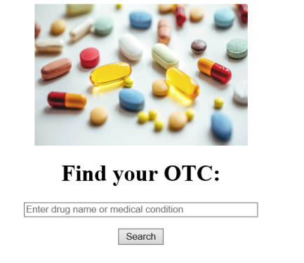
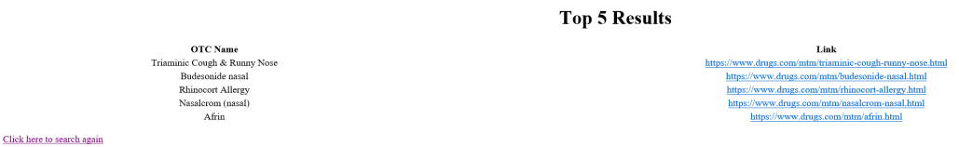
How to use the tool?
http://stardusthuang.pythonanywhere.com/
(free server so unfortunately I cannot change the name)
For people who want to use the tool directly
No software installation needed. Just need a web browser
Use “Flask” and “pythonanywhere” server for building the web application
Where user type in the query
Go back to the search again

Slide 4
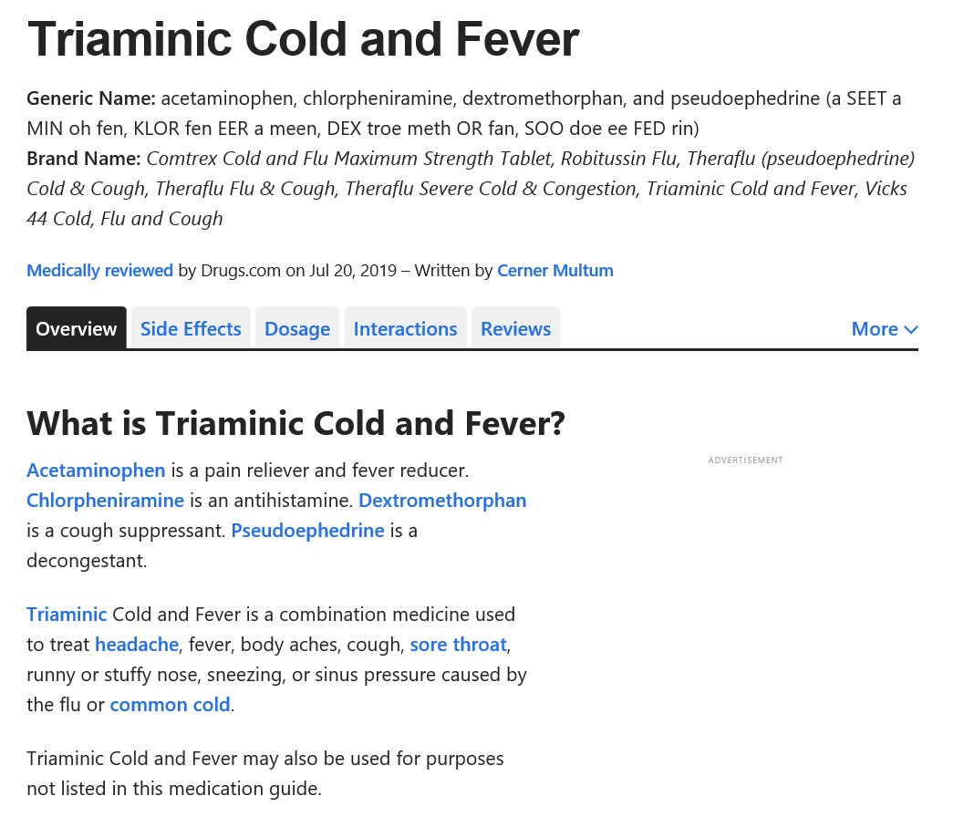
Example
This is the example web page from one of the returned links

Slide 5
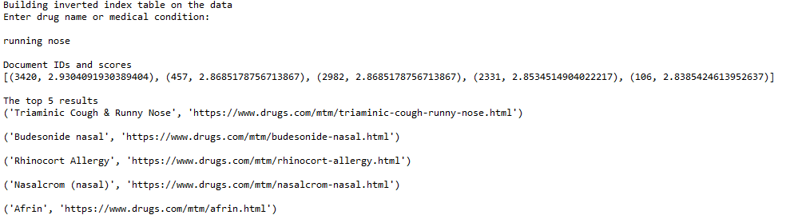
How to run the Program
For software developers who want to extend the capability and update the OTC drugs database from web
Running the Query on command line
Run “FindOTC_local.py”
Can be run from bash terminal and from python IDE
Running the Web Scrapper
Run OTC_WebScraper.py
Code will produce two csv
Medications_links.csv (Contain links to Medication URL which need to be scrapped)
OutputfromWebScraper.csv (Contain information link Medication Name, Medication Type, Full URL Path and Content which is used for Query/Ranking/BM25)
Users’ input
Output results

Slide 6
How to Install the Tools?
Download the repositories from the github link below:
https://github.com/xinkunhuang/OTC_SearchEngine
2. Install dependent library by using pip
# Ensure your pip is up to date
pip install --upgrade pip
# install metapy,pytoml,beautifulsoup4, selenium and pandas
pip install metapy pytoml beautifulsoup4 selenium pandas
3.(Optional) If users want to scrape the data from www.drugs.com again, download the chrome driver file to use "OTC_WebScraper.py": https://sites.google.com/a/chromium.org/chromedriver/downloads

Slide 7
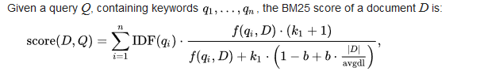
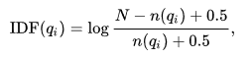
Ranking Function
BM25 ranking function is used to rank documents based on the query.
From Wikipedia:
N is the total documents in the collection
n(qi) is the number of documents containing qi.
F(qi,D) is the term frequency in a document
Avgdl is the average document length in the collection
|D| is the length of the document D in words
For this application, k1 is set to 1.2 and b = 0.75

Slide 8
Flow Chart – Web Scrapping
OTC_WebScraper.py

Slide 9
Results
We have run 10 Query manually and check the Relevance of it .
The results looks promising and it has much bigger scope to further enhance taking consideration of side effects ,reviews and linking to some marketplace where user can directly buy.
S.No | Query | Relevant | Not Relevant
1 | Fever | 5 | 0
2 | Pain in Leg | 5 | 0
3 | Corn and Wart Pain | 5 | 0
4 | Allergy | 5 | 0
5 | Ulcer Stomach | 5 | 0
6 | bacterial infections eyes | 3 | 2
7 | Diarrhea | 5 | 0
8 | Diabetes | 3 | 2
9 | Gout Pain | 5 | 0
10 | Lung Cancer | 1 | 4
Notes:
And this is the results from our search engine.
We manually run 10 query and check the relevance of each one.
The results looks promising.
And this tool can be further expanded to provide more features, such as side effects, reviews and link to marketplace where user can directly buy the otc.

Slide 10
Contribution
Xinkun Huang
Create inverted index table and rank function
Use Flask to create web search engine
Tool evaluation
Voice PPT presentation
Vipin Kataria
Create web scraper to extract OTC data from www.drugs.com
Tool evaluation
Voice PPT presentation

